Slide 1

Markov Processes and their Application to Queueing
Richard C. Larson
1.203J, 15.073J, IDS.700
October 11, 2017

Slide 2

L is a time-average. Explain
λ is average of arrival rate of customers who actually enter the system
W is average time in system (in queue and in service) for actual customers who enter the system

Slide 3
Issues
What about balking? Reneging? Finite capacity?
The lambda of Little’s Law is not necessarily the lambda of the problem statement.
  How do you find the lambda for Little’s Law?
Look at role of γ(t). Can change queue statistics by changing queue discipline.
  How does γ(t) change as one moves from FCFS, to LCFS, to SIRO?

Slide 4
Cumulative # of Arrivals
FCFS=First Come, First Served
SJF=Shortest Job First
FCFS
SJF
L(t)
L_{SJF}(t)
What about LJF,
Longest Job 1st?
0
t = time

Slide 5
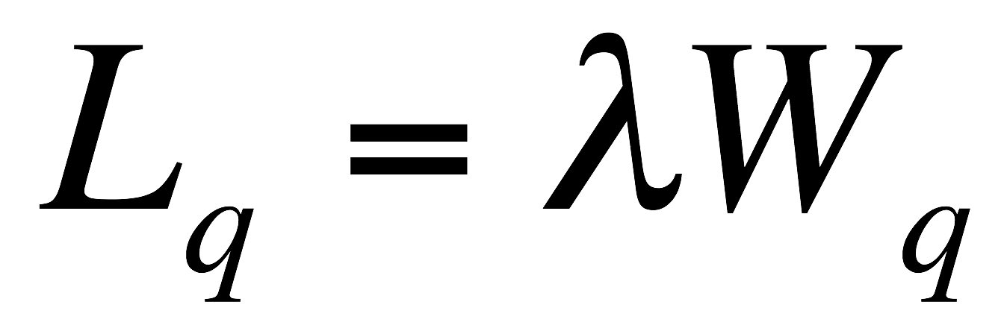
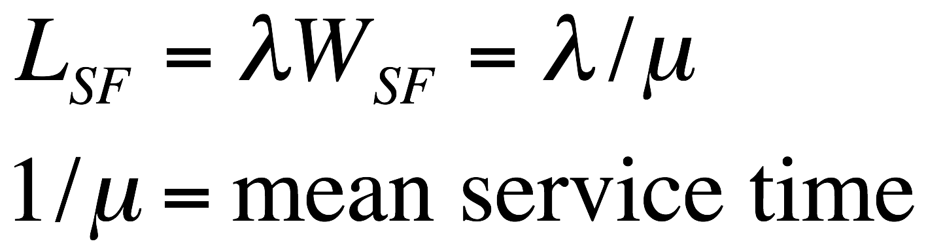
“System” is General
Our results apply to entire queue system, queue plus service facility
But they could apply to queue only!
Or to service facility only!
S.F.

Slide 6
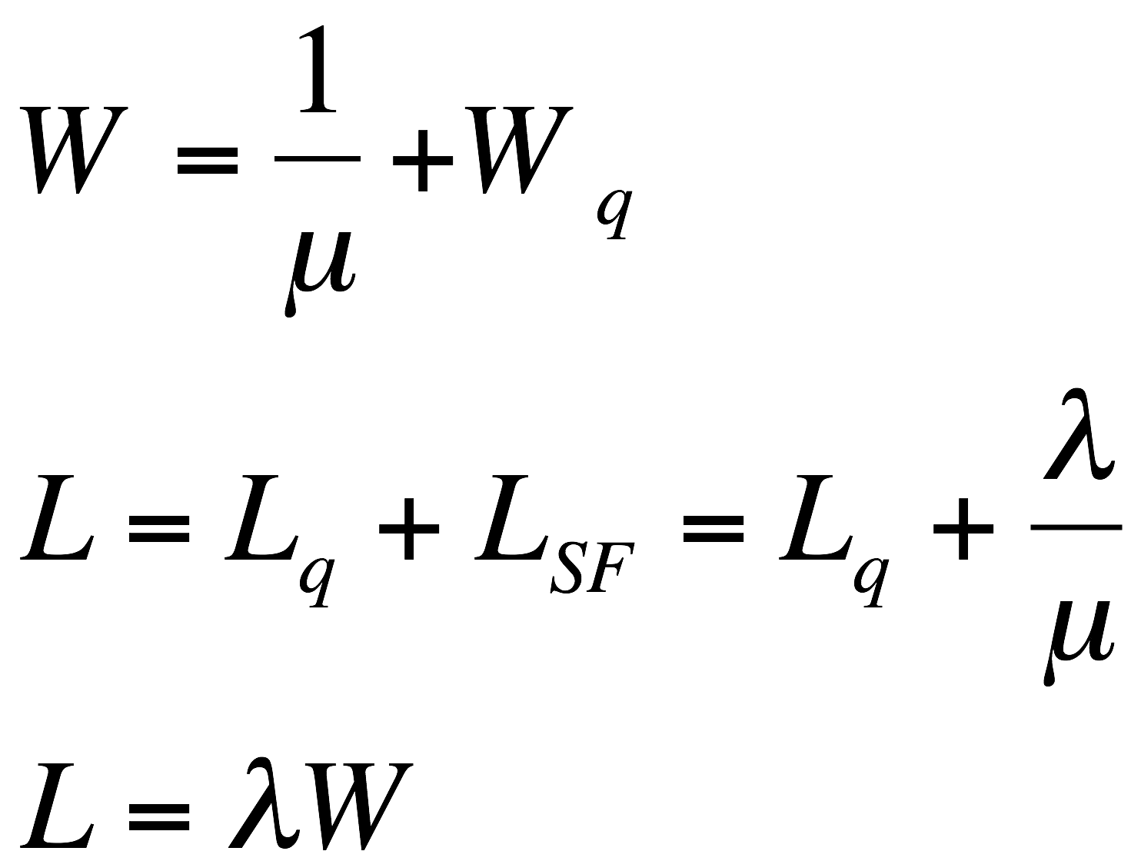
All of this means,
“You buy one, you get the other 3 for free!”

Slide 7
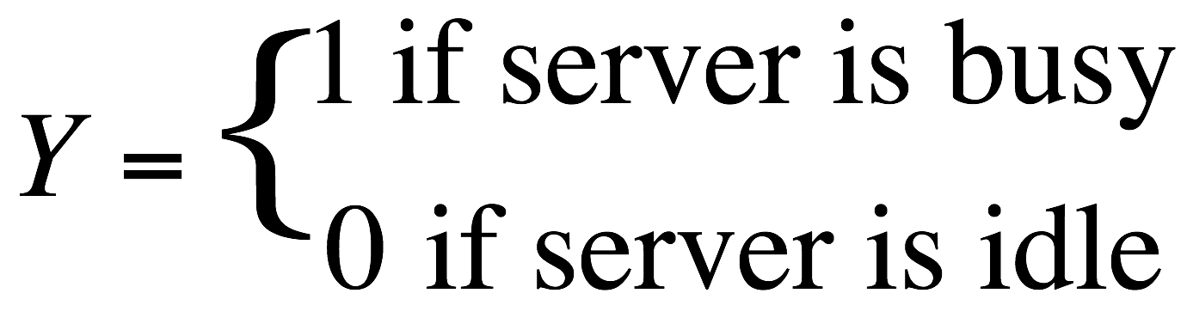
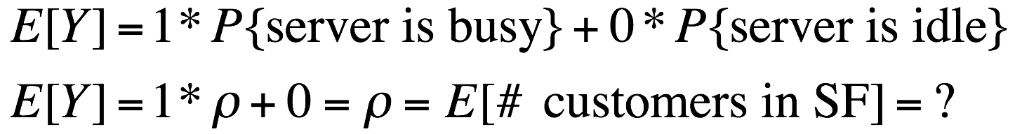
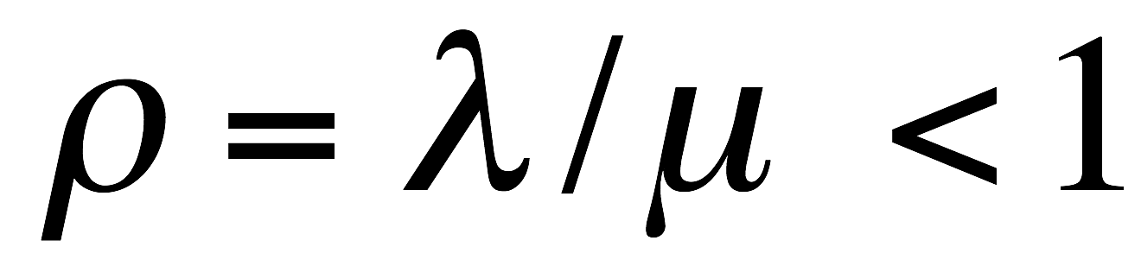
Utilization Factor ρ
Single Server. Set
E[Y] is time-average number of customers in the SF
By Little’s Law,

Slide 8
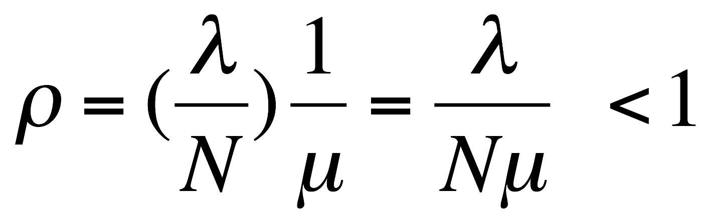
Utilization Factor ρ
Similar logic for N identical parallel servers gives
Here, λ/μ corresponds to the time-average number of servers busy

Slide 9
Markov Queues
Markov here means, “No Memory”

Slide 10
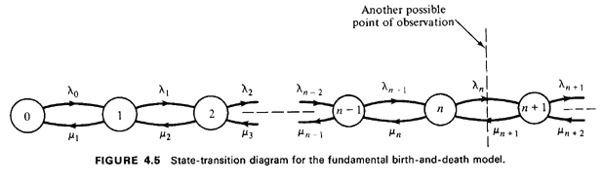

State-Rate-Transition Diagram

Slide 11
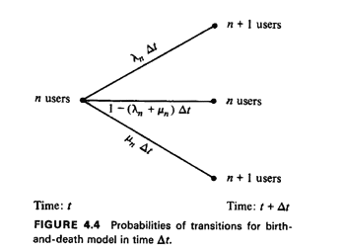




Slide 12
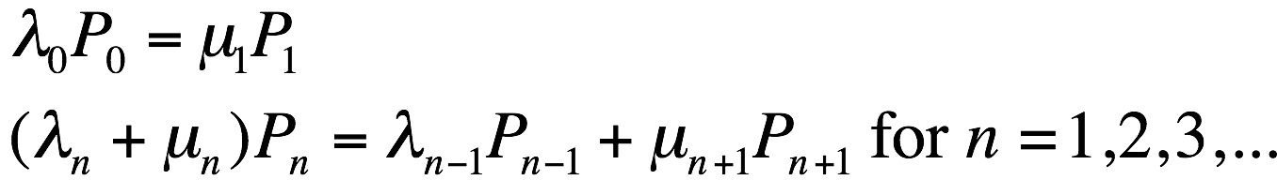
Balance of Flow Equations

Slide 13
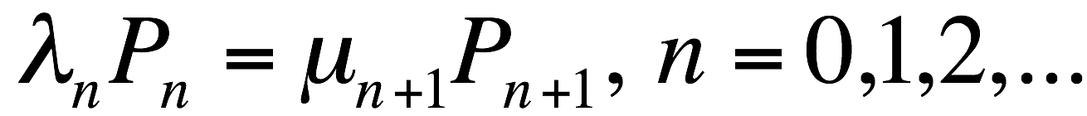
Balance of Flow Equations
Another way to balance the flow:

Slide 14
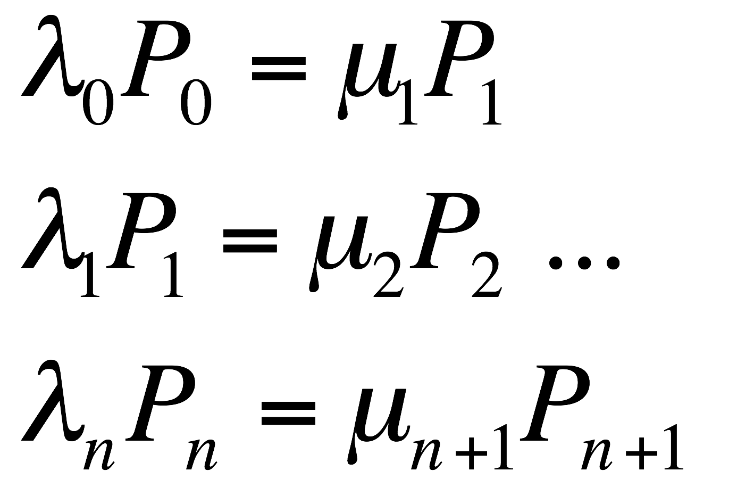
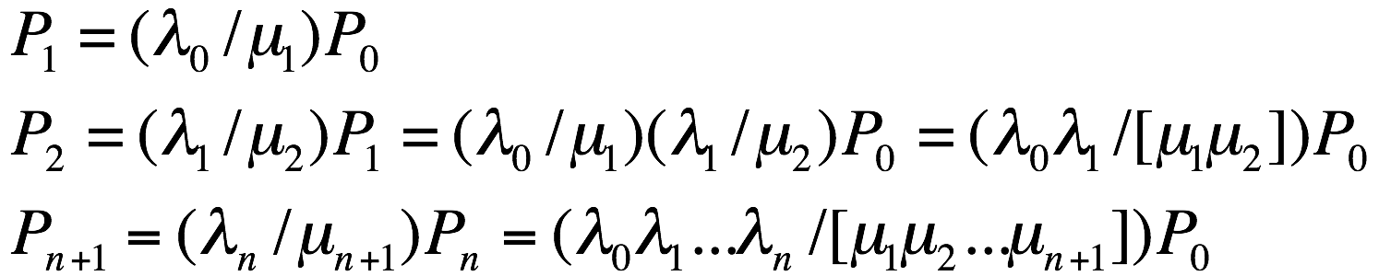


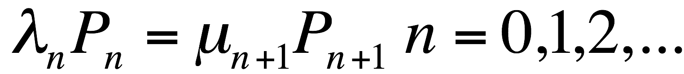
Telescoping!

Slide 15
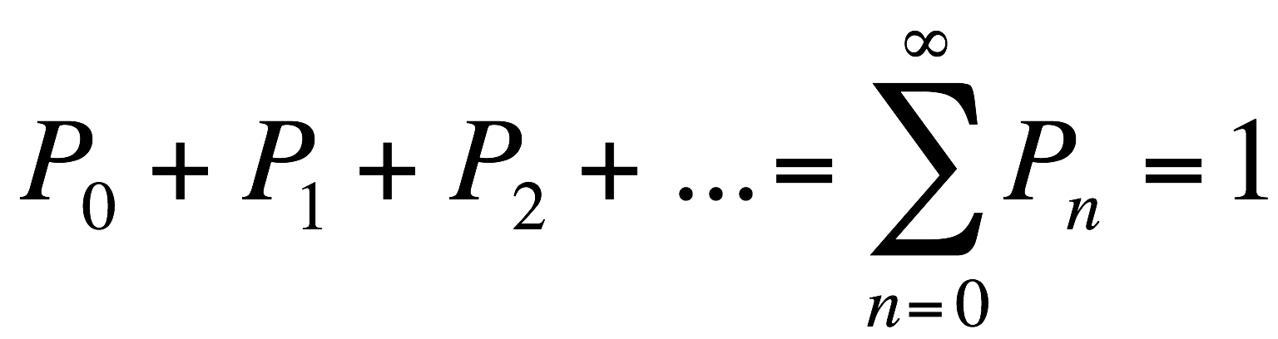
Telescoping!
Now, you easily solve for P₀ and then for
All other P_{n}’s.

Slide 16
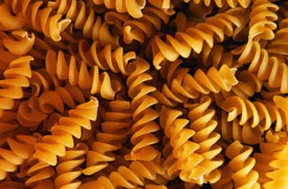
PASTA: Poisson Arrivals See Time Averages
Pedestran Crossing Light Under Rule B?
http://www.nationalgeographic.com/xpeditions/activities/images/pasta.jpg

Slide 17
Blackboard Modeling
3 server zero line capacity
3 server capacity for 4 in queue
Same as above, but 50% of queuers balk due to having to wait in queue
Single server who slows down to half service rate when nobody is in queue
More?? ….

Slide 18
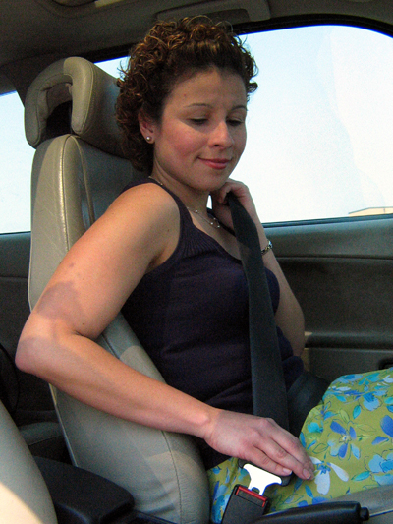
Time to
Buckle your
Seatbelts!
http://www.census.gov/pubinfo/www/multimedia/img/seatbelt-lo.jpg

Slide 19
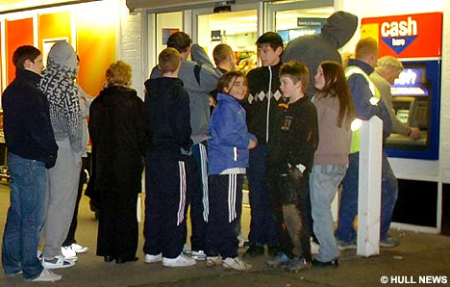

Slide 20
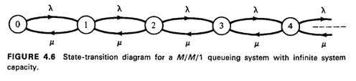
The M/M/1 Queue
For λ/μ < 1.

Slide 21
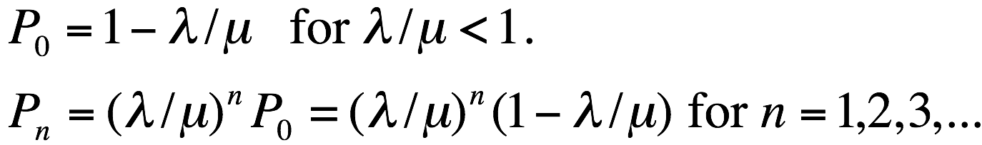
The M/M/1 Queue
For λ/μ < 1.

Slide 22
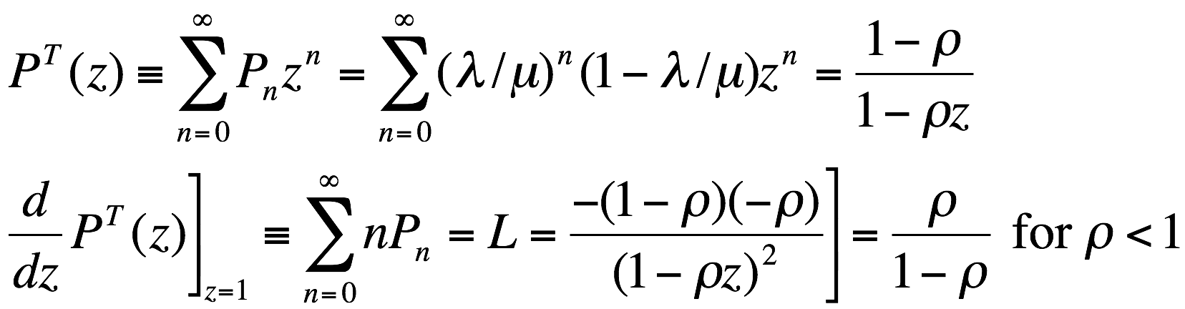
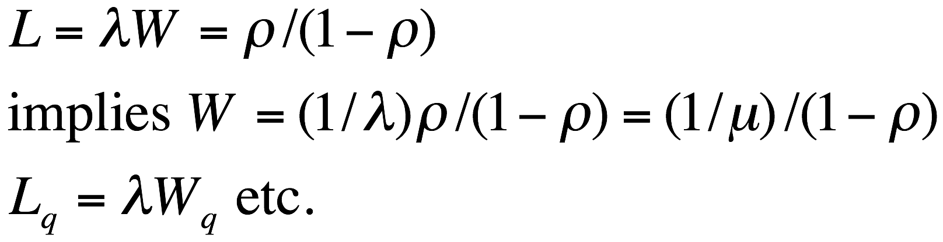
The M/M/1 Queue

Slide 23
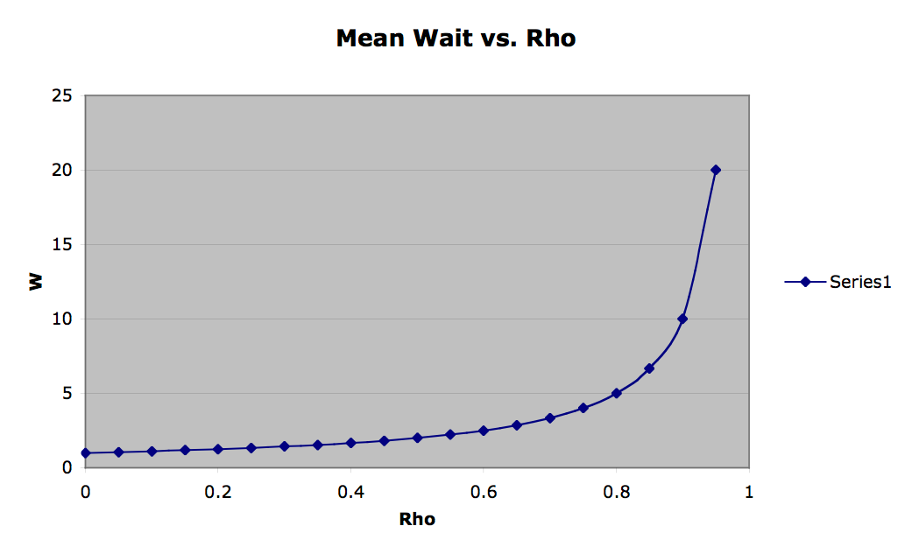

Note the Elbow!

Slide 24
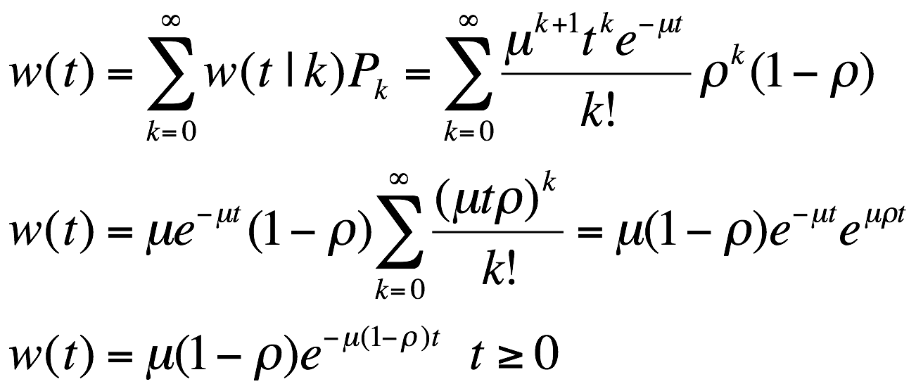

http://www.sweetricks.com/ImagesLol/Smiley%20Face.JPG
More on M/M/1 Queue
Let w(t) = pdf for time in the system (including queue and service)
Assume First-Come, First-Served (FCFS) Queue Discipline
(k+1)-order Erlang
Exercise: Do the same for Time in queue

Slide 25
About the ‘cut’’ between states to
write the balance of flow equations…
1,0
1,1
0,0
0,1

Slide 26
What about the
Pedestrian Crossing Light
Operating under Rule B?

Slide 27
So, the balance-of-flow argument
to determine steady state
probabilities applies to more
general systems, not
Just Birth & Death Processes

Slide 28
What is an
embedded Markov Chain?

Slide 29
Optional Exercise:
Is it ‘’better’’ to enter a single server queue with service rate μ or a 2-server queue each with rate μ /2?
Can someone draw one or both of the
state-rate-transition diagrams?
Then what do you do?

Slide 30
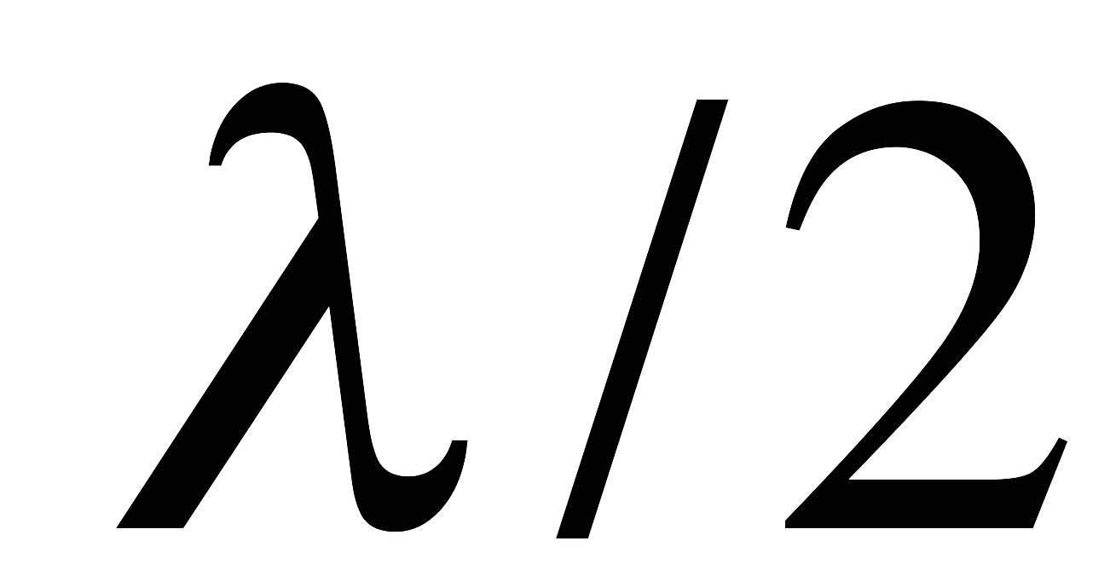
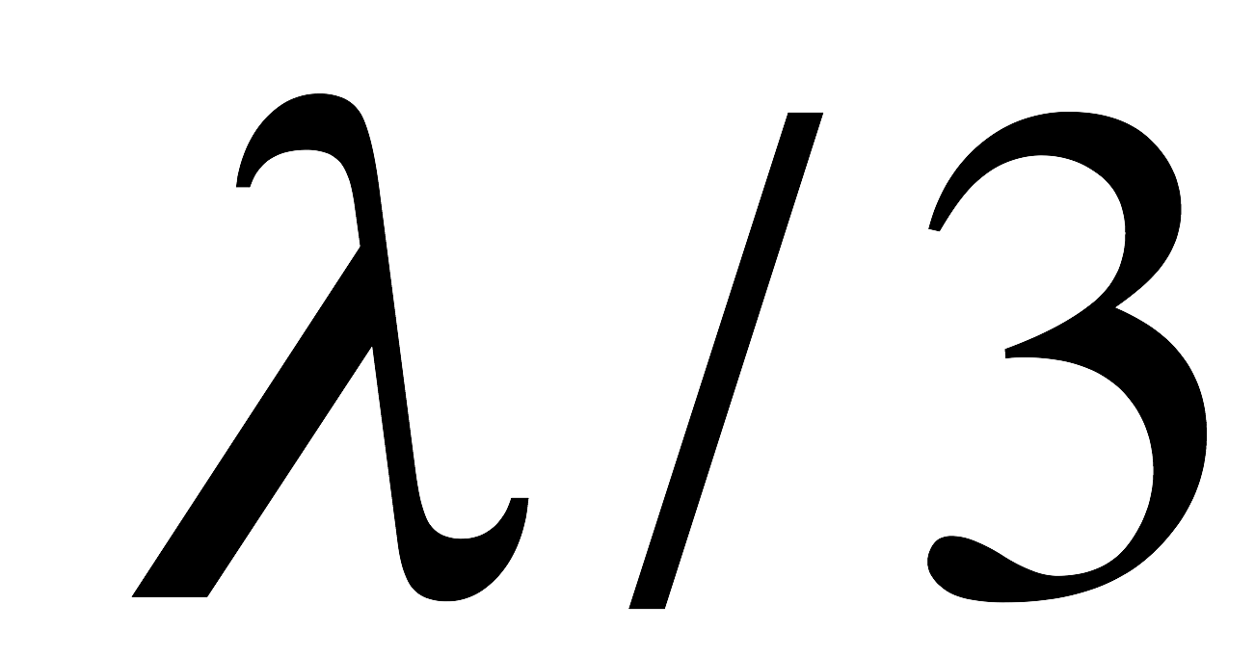
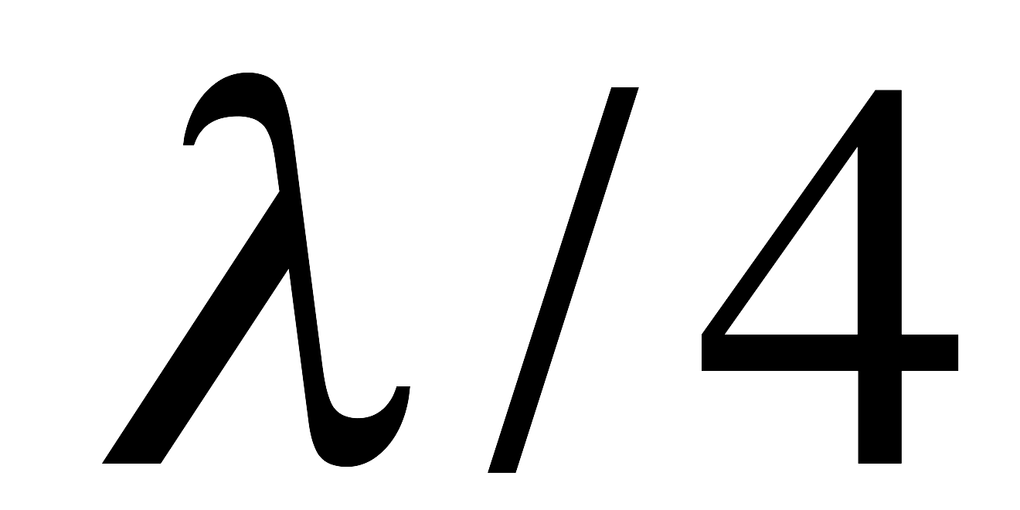
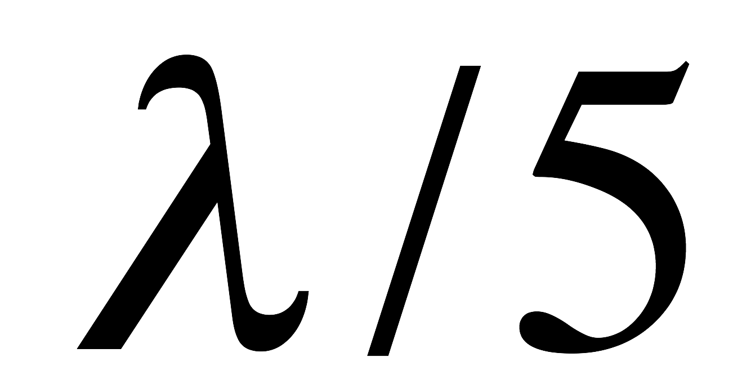
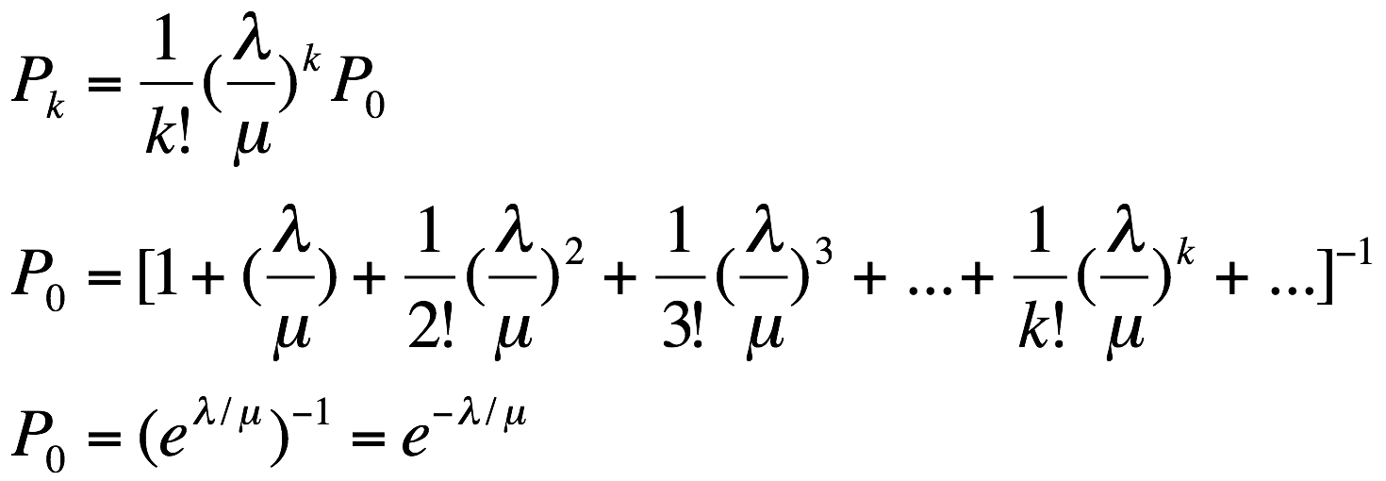
Final Example:
Single Server, Discouraged Arrivals
State-Rate-Transition Diagram, Discouraged Arrivals
k = 0, 1, 2, …

Slide 31
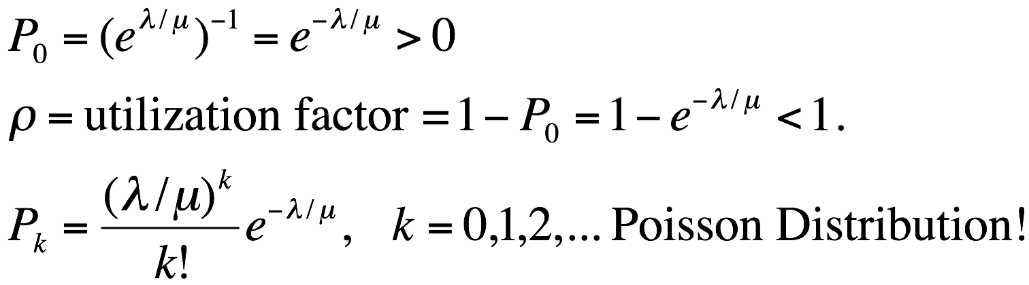
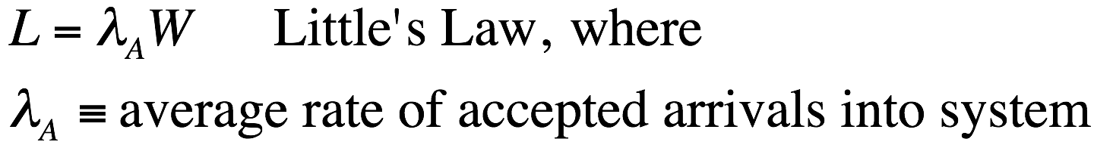

Slide 32
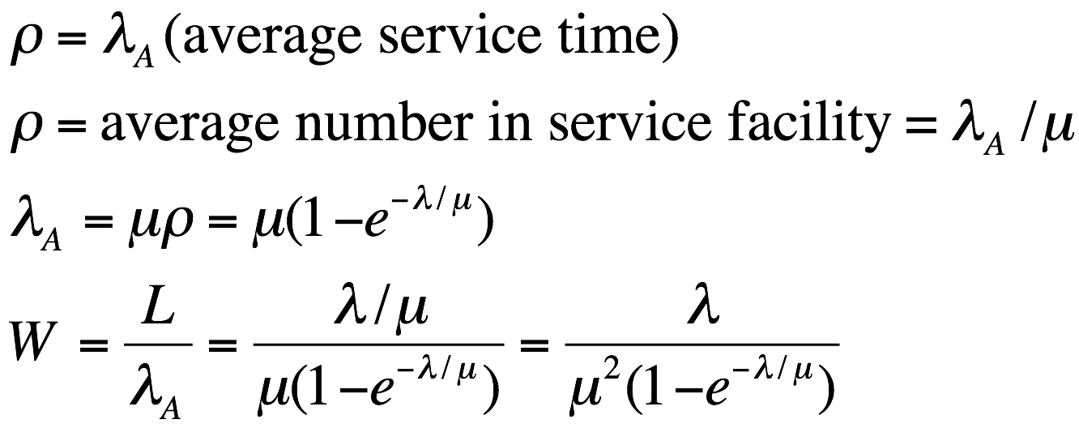

http://www.fdcw.unimaas.nl/cwsiot/shopwindow/music/Floor%20Manschot%20&%20Michiel%20Stoter/plaatjes/happiness.jpg
Apply Little’s Law to Service Facility

